Slide 1
CSE 5914 – Almost Grads
Watson Weather Project
John Herwig, Luke Swint, Holland Clarke
Notes:
struggled wit fligh thing, too many results for airport code, demo of what happened there, and then hwth hdigh thj ji, final have all weather stuff working perfectly

Slide 2
CSE 5914 – Almost Grads
Our Application
Web app with ability to assist with planning through the communication of a Watson Assistant
App Evolution
Weather app
Weather with trip suggestions (flight api)
Weather with restaurant suggestions (yelp api)
2 Major Pieces
Weather Portion
Restaurant Portion
Notes:
struggled wit fligh thing, too many results for airport code, demo of what happened there, and then hwth hdigh thj ji, final have all weather stuff working perfectly

Slide 3
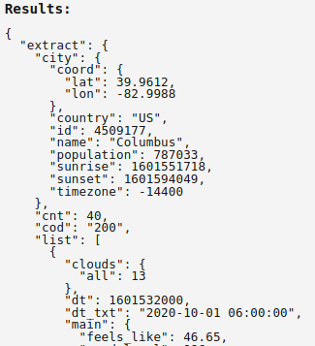
CSE 5914 – Almost Grads
Our Application
Weather Portion
Given location info, Chatbot provides weather data
Connected to OpenWeatherMap API
Notes:
struggled wit fligh thing, too many results for airport code, demo of what happened there, and then hwth hdigh thj ji, final have all weather stuff working perfectly

Slide 4
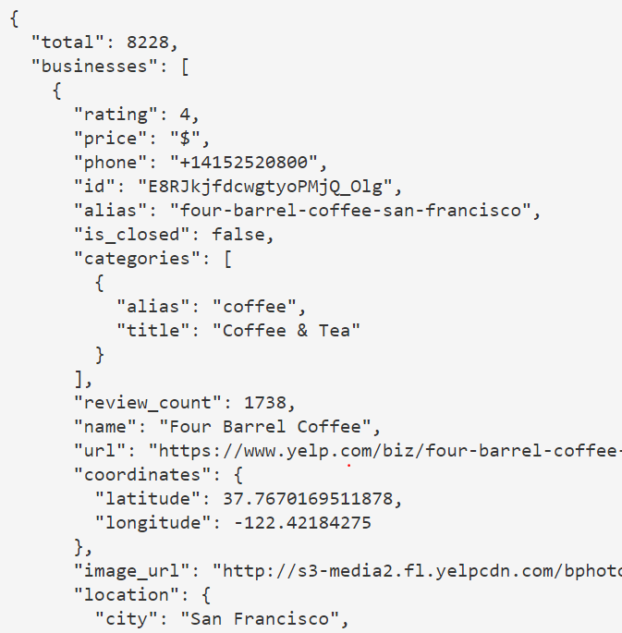
CSE 5914 – Almost Grads
Our Application
Restaurant Portion
Using location/weather date, Chatbot provides a location suggestion
Connected to Yelp API
Notes:
struggled wit fligh thing, too many results for airport code, demo of what happened there, and then hwth hdigh thj ji, final have all weather stuff working perfectly

Slide 5
CSE 5914 – Almost Grads
Progress
Properly Working
Website is successfully deployed to Heroku
Attractive UI
Watson assistant provides all weather info!
Roadblocks
City Specification w/ weather info
Flight API – location specification & parsing results
Further investigation during demo
Notes:
struggled wit fligh thing, too many results for airport code, demo of what happened there, and then hwth hdigh thj ji, final have all weather stuff working perfectly

Slide 6
CSE 5914 – Almost Grads
Final Timebox Goals
If Yelp API can be successfully connected
Restaurants near by
Recommendations based on weather in are
If time constraints restrict Yelp API implementation
Add dialog to Chatbot to understand different word phrasing and mistypes
Add extra weather information
Refine the appearance of the web application
Auto-populating user location

Slide 7
Demo

